Slide 1













Thank You Sponsors
Monica Merante & Brian Cornue
CNY YOUTH
2025
MENTAL
HEALTH
SUMMIT
PRESENTED BY

Slide 2


2025
CNY YOUTH
MENTAL
HEALTH
SUMMIT
PRESENTED BY
From Burnout to Balance
Recognizing & Preventing Compassion Fatigue
Rachel Johnson, MSW, LMFT
SESSION SPONSORED BY

Slide 3

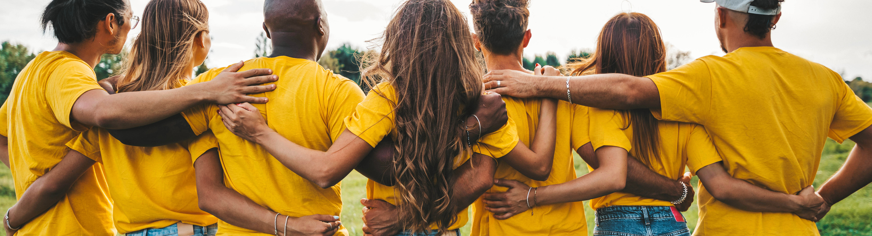
CARING FOR OUR MENTAL HEALTH
From Burnout to Balance – Recognizing and Preventing Compassion Fatigue
Notes:
“Welcome everyone to Caring for OUR Mental Health. This space is designed just for you—helpers, healers, and care professionals who pour so much into others. Today, we pause to pour into you.”

Slide 4


What We’ll Explore Today
Understanding burnout & compassion fatigue
Recognizing early signs
The science of stress
Tools for regulation & renewal
Building resilience — personally & collectively
Notes:
"Today, we’ll explore how our work as care providers intersects with stress, burnout, and larger systems. You’ll leave with practices, tools, and (hopefully) a lighter spirit.”

Slide 5


The Lens of Delivery
“trauma-informed” practice
social justice lens
black women
many privileges
self-proclaimed “do gooder”
a tinsy bit “woo-woo”
a smidge of big nerd energy

Slide 6
Grounding & Agreements
Confidentiality & care
Be present, not perfect
Take what you need, leave what you don’t
Honor your capacity
Notes:
“Take a deep breath in… and exhale slowly. Feel your feet grounded. You’ve done enough today just by being here.”

Slide 7
check-in
"what brought you into this work?"
Notes:
“This session is not about doing more. It’s about feeling more like yourself again.”

Slide 8
“Caring for myself is not self-indulgence, it is self-preservation, and that is an act of political warfare.”
cred: Audre Lorde

Slide 9
Defining the Terms
Burnout:
Emotional exhaustion, depersonalization, and reduced sense of accomplishment caused by chronic workplace stress.
Compassion Fatigue:
Emotional residue or strain from exposure to others’ suffering
Notes:
Clarify that burnout often comes from systems and workload, while compassion fatigue stems from empathic engagement.
“These overlap — especially for helpers, educators, and advocates.”

Slide 10
The Cost of Caring
Emotional overload
Cynicism or withdrawal
Reduced empathy
Physical fatigue
Loss of joy or meaning
Notes:
Ask: “How many of you have ever said, ‘I’m fine,’ while knowing you’re not?”
Pause for hands or laughter — normalize the experience.

Slide 11
The Stress Cycle
Stress is not the problem — it’s being stuck in stress.
Chronic stress → keeps the nervous system activated → leads to exhaustion, illness, and detachment.
Notes:
Briefly describe the “fight-flight-freeze-fawn” responses.
“We can’t think our way out of stress. We have to complete the cycle — through breath, movement, laughter, or connection.”

Slide 12
Reflection Activity – Check Your Tank
What fills your tank?
What drains it?
How do you know when you’re running on empty?
Notes:
Give 5 minutes for small group discussion. Debrief: “Notice patterns. What’s in your control — and what’s not?”

Slide 13
Warning Signs
Emotional: irritability, guilt, hopelessness
Cognitive: forgetfulness, cynicism, tunnel vision
Physical: headaches, tension, fatigue
Behavioral: withdrawal, procrastination, boundary-blurring
Notes:
Encourage participants to reflect quietly. “Which of these show up for you first?”

Slide 14
Regulation vs. Resignation
When stress hits:
Resignation says, “This is just how it is.”
Regulation says, “I need to pause, reset, and breathe.”

Slide 15
Tools for Renewal
Movement & mindfulness
Restorative rituals (music, journaling, prayer, nature)
Peer support & supervision
Boundaries & balance audits
Celebrate small wins
Notes:
Encourage “micro-recoveries” — short resets throughout the day, not just vacations.

Slide 16
hard truth #1
we can’t “therapitize” the isms
we can’t “woo-sah” our way our of poverty

Slide 17
Mental Health ≠ Individual Fix for Systemic Harm
Therapy, mindfulness, breathwork, and wellness practices are powerful—but they are not cures for racism, patriarchy, poverty, homophobia, ableism, or state violence.
Many helping spaces unintentionally send the message: “If you just heal your trauma, shift your mindset, breathe deeper—you’ll be fine.”
But the root causes of harm are structural, not personal. Healing does not remove us from systems that are designed to exploit, oppress, or exhaust us.

Slide 18
Self-Regulation Isn’t a Replacement for Liberation
We can breathe deeply and still be underpaid.
We can go to therapy and still be policed.
We can set boundaries and still experience burnout in under-resourced communities.
The idea that we can “out-heal” systemic oppression places responsibility on the individual instead of holding systems accountable.

Slide 19
Wellness Is Not a Cure for Economic Injustice
“Woo-sah” culture—deep breathing, affirmations, and sage—won’t pay rent, secure childcare, or erase debt.
Poverty is violence. Underfunded schools, lack of access to healthcare, housing insecurity—these are not mindset issues. They are policy failures.

Slide 20
so what can we do?

Slide 21
Use healing practices as tools for survival, not solutions for injustice.
They help us stay grounded, but they are not the end goal.
Balance personal healing with systemic analysis.
Ask: What do I need to feel well? And what needs to change in the system so my community can thrive?
Center collective care and mutual aid. Our wellness is interdependent.
Liberation work must include rest, reflection, and resource redistribution.

Slide 22
“You are not broken. The system is.”

Slide 23
“Tending to your own wounds is part of tending to the world’s wounds.”
cred: adrienne maree brown

Slide 24
hard truth #2
your ego is too much in the work

Slide 25
Replacing ego and martyrdom in helping work protects our mental health
Ego Says “I Have to Save Everyone.”
Healing Says “I Am Part of a Collective.”
Ego and martyrdom isolate us and put the weight of entire systems on our shoulders.
Releasing that pressure allows for shared responsibility and more sustainable impact.
Martyrdom Leads to Burnout.
Sustainability Comes from Boundaries.
When we equate self-sacrifice with dedication, we drain ourselves to the point of depletion.
Choosing rest, delegation, and saying “no” protects our energy and prolongs our ability to stay in the work.
Ego Craves Control.
Healing Embraces Trust.
Ego wants to manage every outcome.
Trusting others, the process, and the power of community helps us let go of the anxiety that comes with hyper-responsibility.

Slide 26
Replacing ego and martyrdom in helping work protects our mental health
Martyrdom Makes the Work About Us.
Liberation Work Is Bigger Than Any One Person.
Helping isn’t about being a hero—it’s about being in right relationship.
When we center community instead of ourselves, we make space for collaboration, innovation, and collective healing.
Ego Blocks Vulnerability.
Healing Requires Authenticity.**
Pretending we’re always okay disconnects us from others and ourselves.
Being honest about our limits, struggles, and needs helps break the stigma and encourages others to do the same.
Letting Go of Martyrdom Creates Room for Joy
When we release the belief that struggle equals worthiness, we make space for ease, joy, and creativity.
Joy is not the enemy of justice—it’s fuel for it.

Slide 27
“To be a healer is to be a witness. To be a witness, we must be present. And to be present, we must be well.”

Slide 28
body check

Slide 29
Energy Mapping
What depletes me (power down)?
What restores me (power up)?

Slide 30
breathe, stretch, shake... let it go...

Slide 31
Permission Slips
Write yourself a permission slip: "I give myself permission to..."

Slide 32
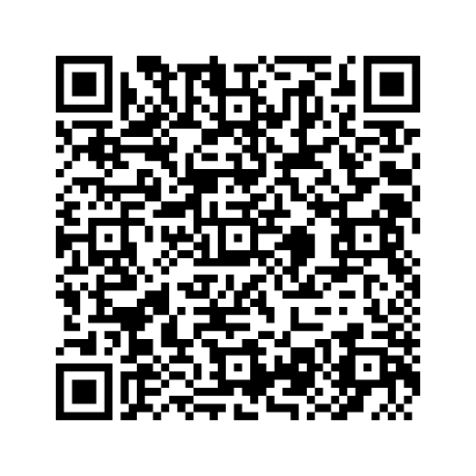
get connected

Slide 33




stay connected.
thank you.
info@halfhoodhallfholistic.com
www.halfhoodhalfholistic.com
@halfhoodhalfholistic

Slide 34
Three Offerings:
“Heal the Healers”workbook
Merch
Full Engagement

Slide 35
Session 3 Breakouts
Let the Body Lead: An Embodied Approach to Healing Eating Disorders and Other Chronic Stress Responses Holly Lowery-Davis, Somatic Practitioner and Coach
Liberty I
Internet Generation and Adolescence: Cell Phones, Social Media, and Brain Development Matthew Mulvaney, Ph.D. Liberty II

Slide 36
Thank You Sponsors
Monica Merante & Brian Cornue
CNY YOUTH
2025
MENTAL
HEALTH
SUMMIT
PRESENTED BY

