Slide 1




2025
CNY YOUTH
SCHOOL
PANEL
MENTAL
HEALTH
SUMMIT
PRESENTED BY
Internet Generation and Adolescence:
Cell Phones, Social Media, and Brain Development
Matthew Mulvaney, Ph.D.
SESSION SPONSORED BY

Slide 2
Social Media, Phones, and Adolescent Mental Health
Matthew Mulvaney
Department of Human Development and Family Science

Slide 3
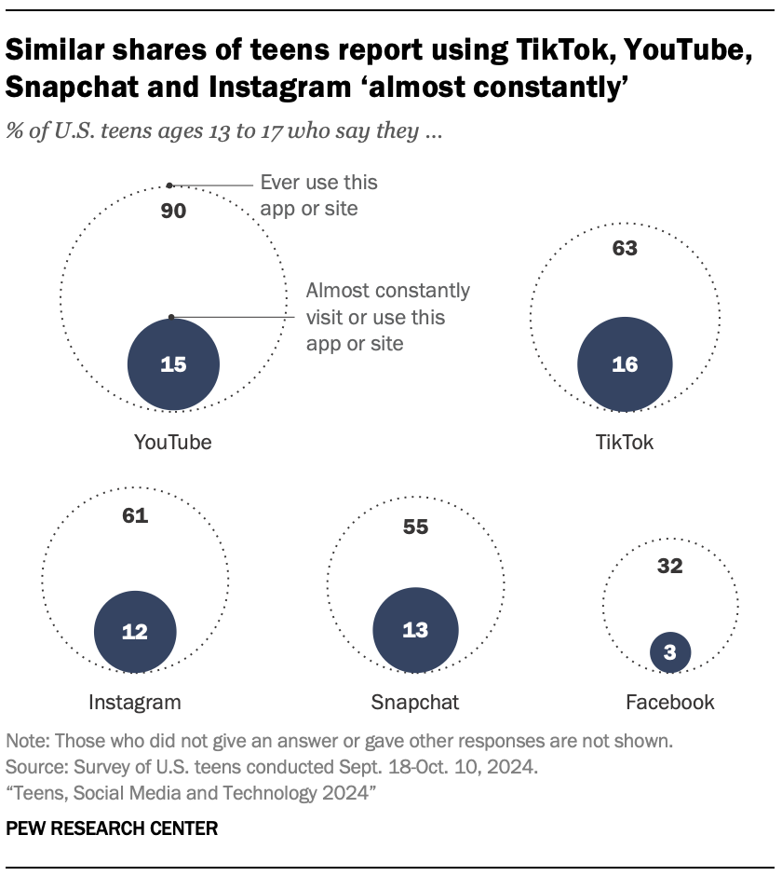
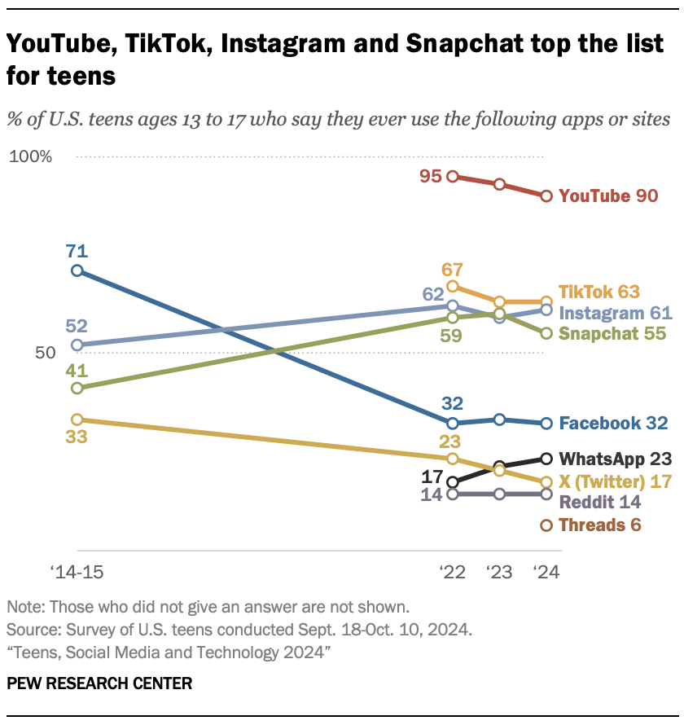
From: https://www.pewresearch.org/internet/2024/12/12/teens-social-media-and-technology-2024/

Slide 4
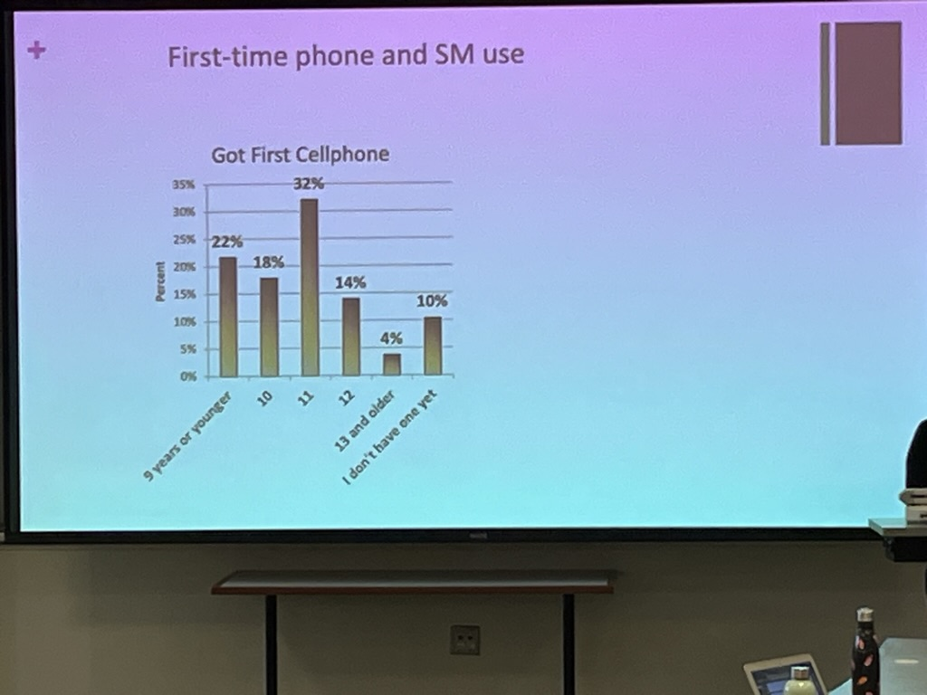
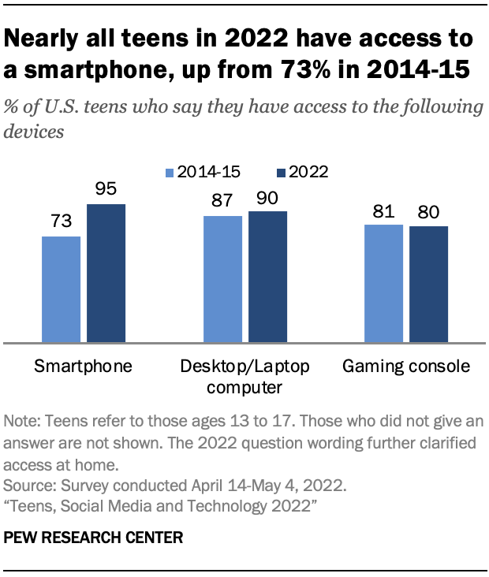
Teens and Smartphones
From: Charmaraman, 2023

Slide 5
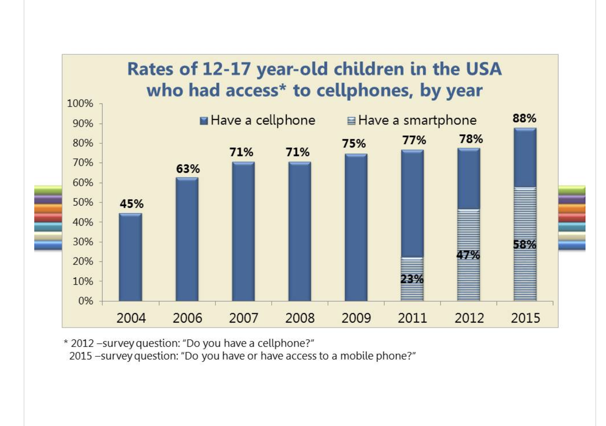
Teens and Smartphones

Slide 6
From: Twenge and Park, 2017

Slide 9
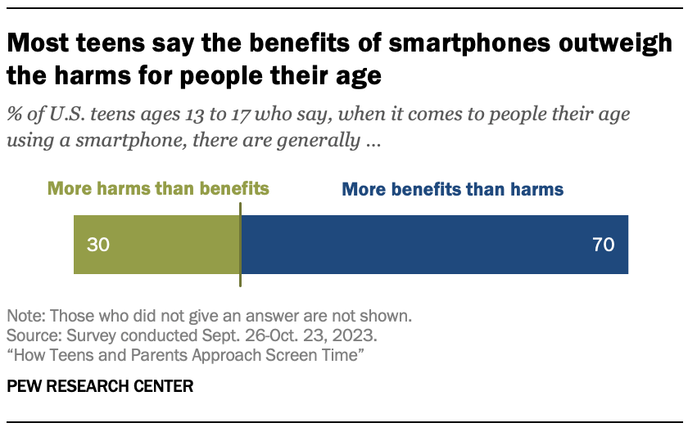
Teens Perceptions of Phones

Slide 10
Correlation ≠ Causation

Slide 11
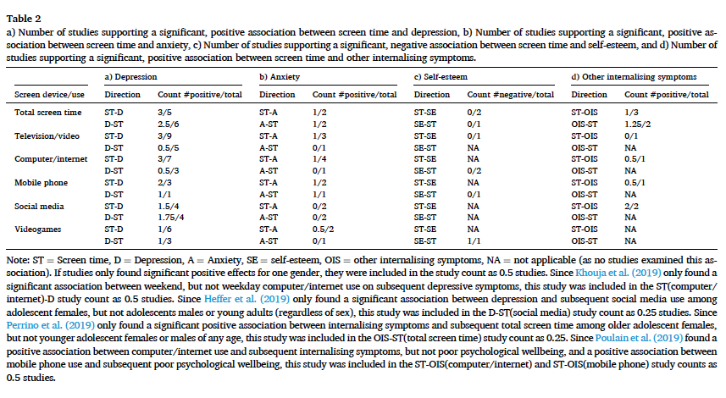
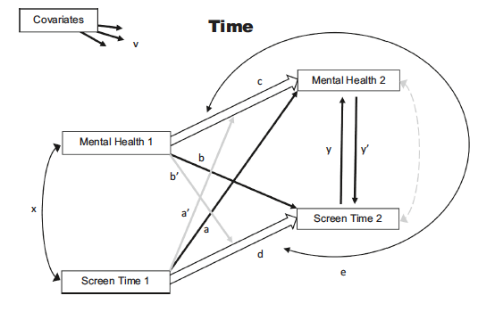
From: Tang et al., 2021

Slide 12
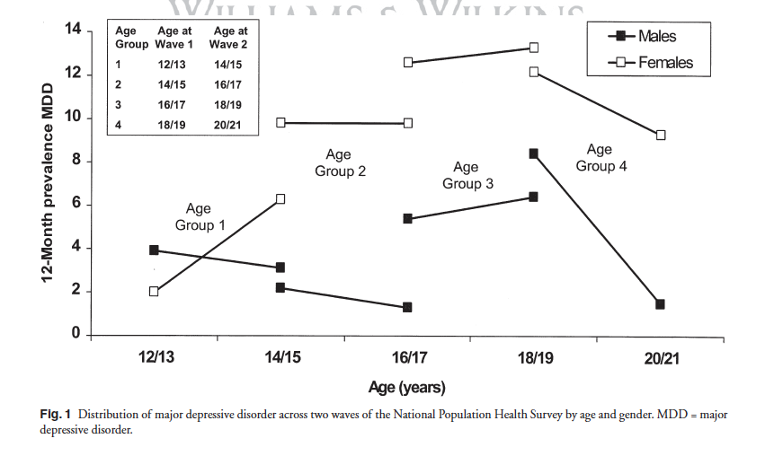
Earlier Gender Differences in Depression
From: Wade, Cairney, & Pevalin, 2002

Slide 13
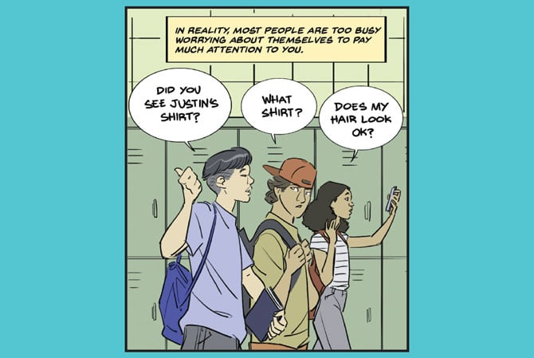
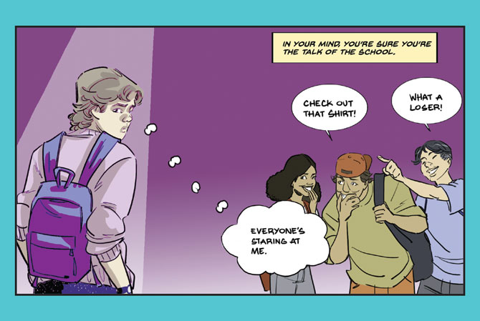
Adolescent Egocentrism and Social Media

Slide 14
Brain Development and Social Media

Slide 15
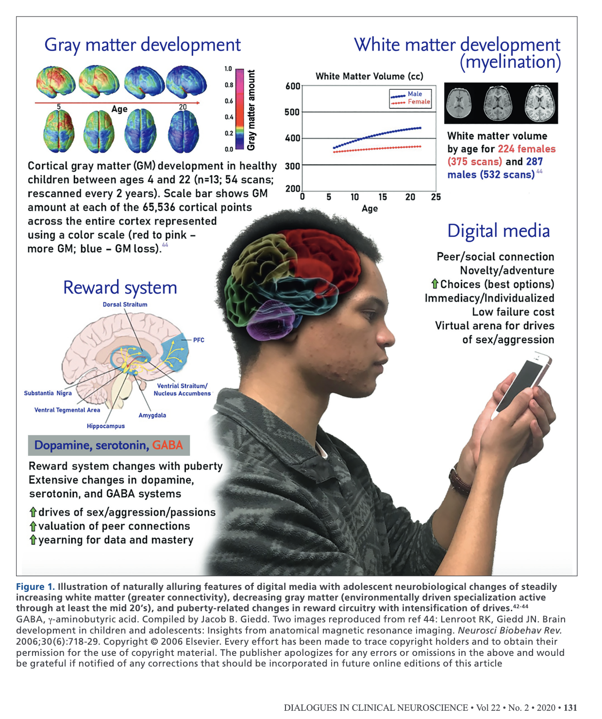

Slide 16
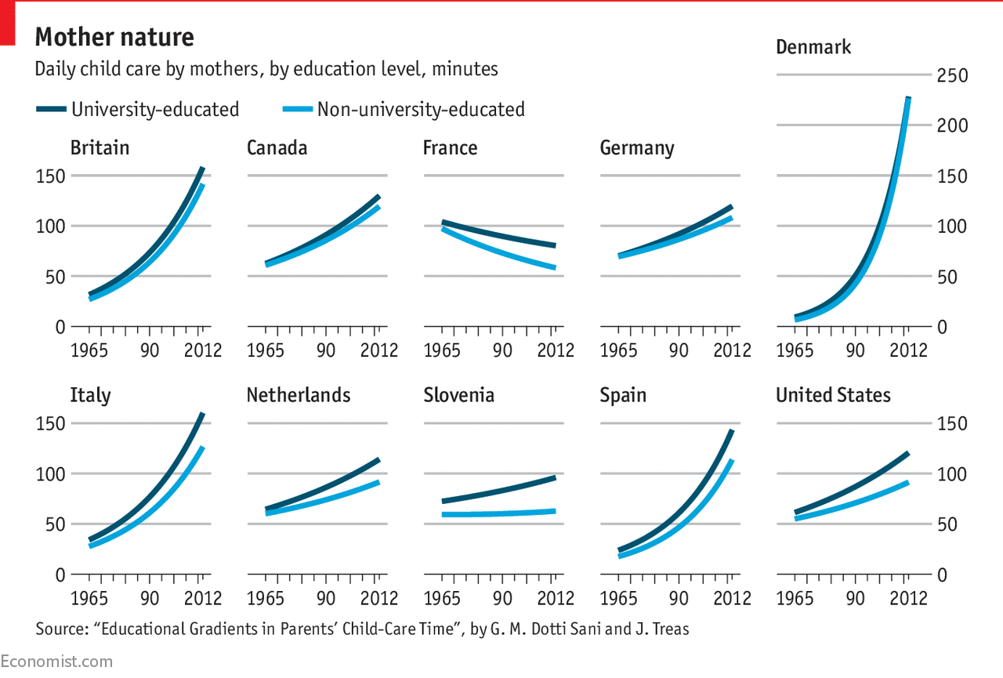
Helicopter Parenting

Slide 17
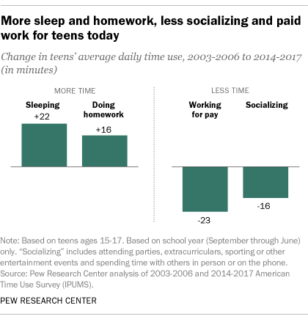
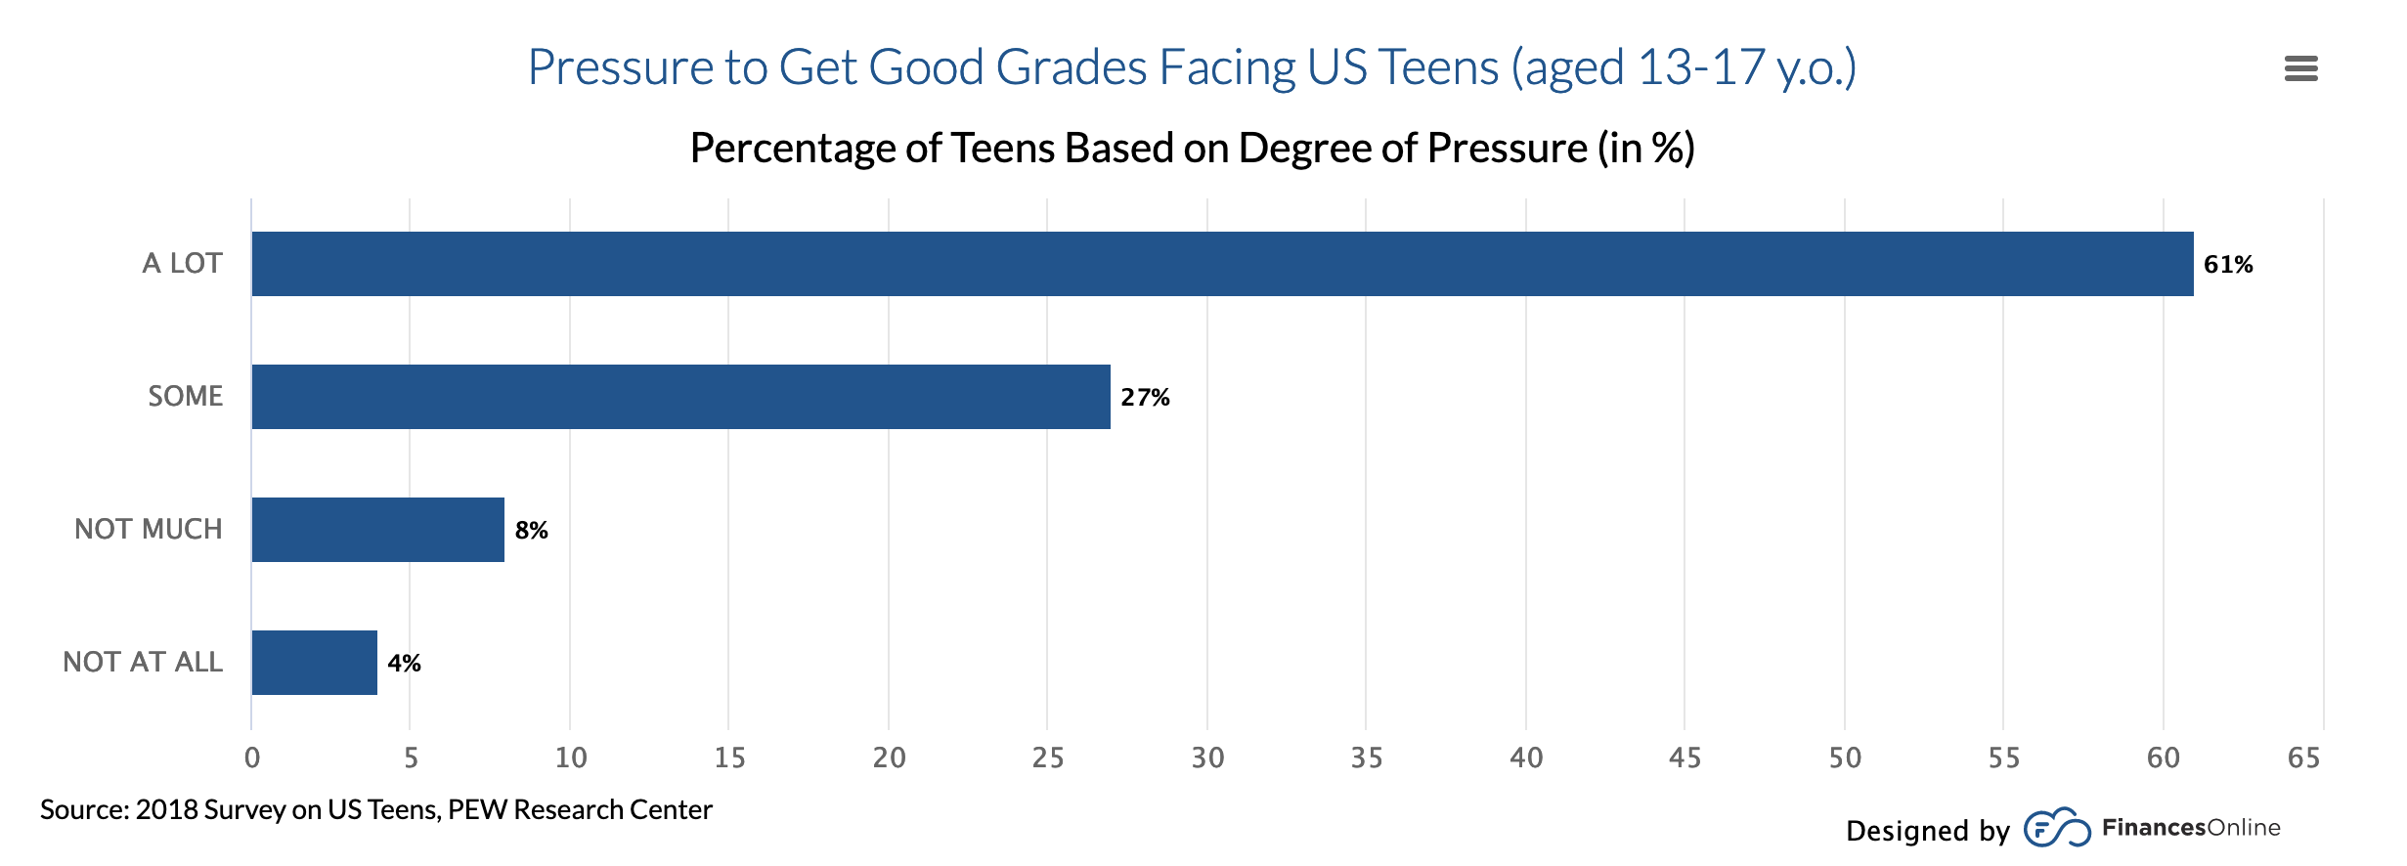
Change in Academic Pressures

Slide 18
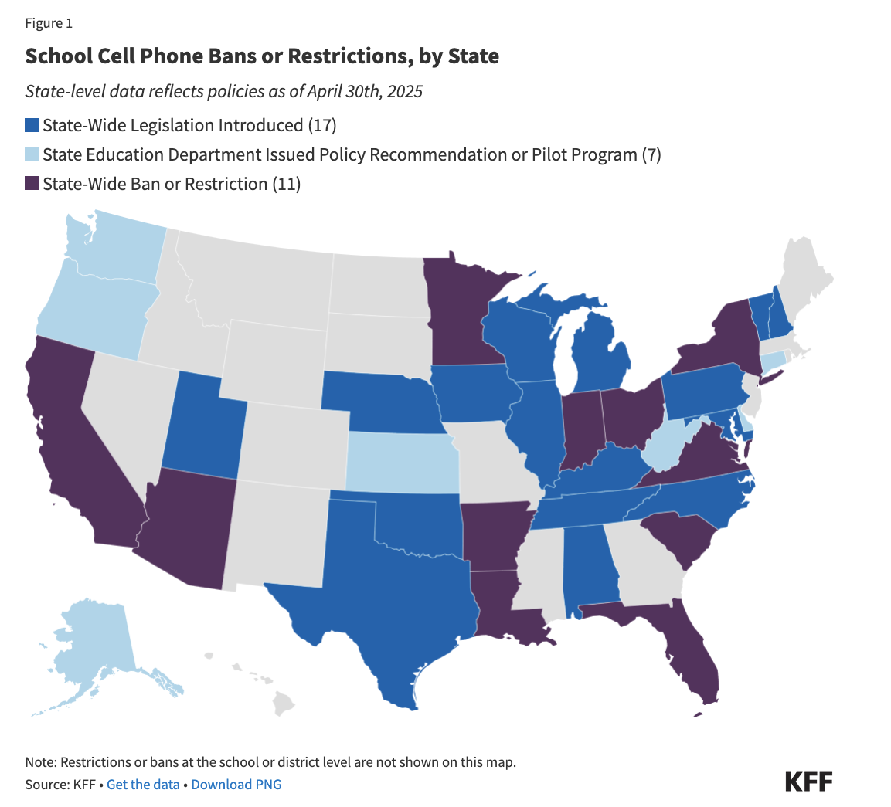
School Bans?
This new requirement will take place in the 2025-26 School Year and applies to all schools in public school districts, as well as charter schools and Boards of Cooperative Educational Services (BOCES).
Governor Hochul’s cellphone policy creates a statewide standard for distraction-free schools in New York including:
No unsanctioned use of smartphones and other internet-enabled personal devices on school grounds in K-12 schools for the entire school day (from “bell to bell”), including classroom time and other settings like lunch and study hall periods.
From: https://www.governor.ny.gov/news/distraction-free-schools-governor-hochul-announces-new-york-become-largest-state-nation
https://www.kff.org/mental-health/issue-brief/a-look-at-state-efforts-to-ban-cellphones-in-schools-and-implications-for-youth-mental-health/

Slide 19
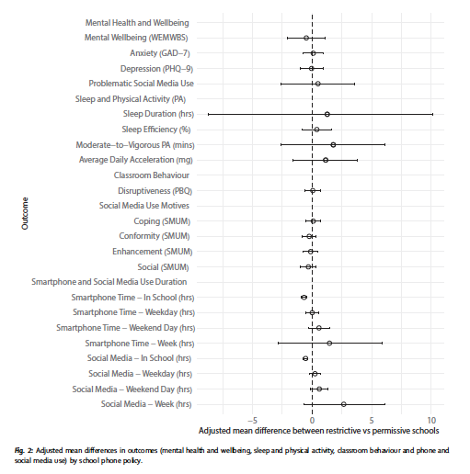
“In Sweden, we find no impact of mobile phone bans on student performance and can reject even small-sized gains.” From: Kessel, Hardardottir, Tyrefors 2020
“Linear mixed models indicated that ban and no ban school groups
did not differ significantly in terms of problematic phone use, academic engagement, and school
belonging.” From: King et al. 2024
From: Goodyear et al., 2025

Slide 20

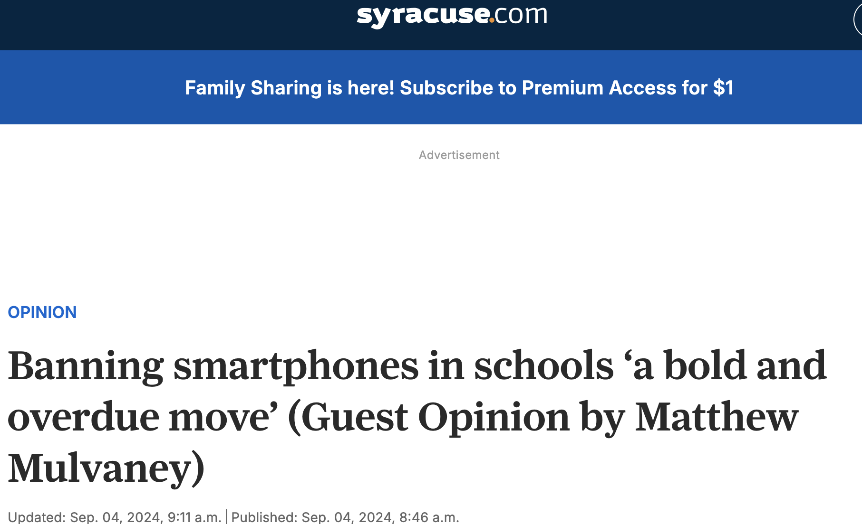

Moral Panic?

Slide 21
Haidt Suggestions
No smartphones before 14
No social media before 16
Ban phones in schools
Promote play-based childhood
https://www.movieguide.org/news-articles/jonathan-haidts-4-simple-rules-to-solve-child-screen-addiction.html

Slide 22
Thank you!

Slide 23











Thank You Sponsors
Monica Merante & Brian Cornue
2025
CNY YOUTH
MENTAL
HEALTH
SUMMIT
PRESENTED BY

