Slide 1

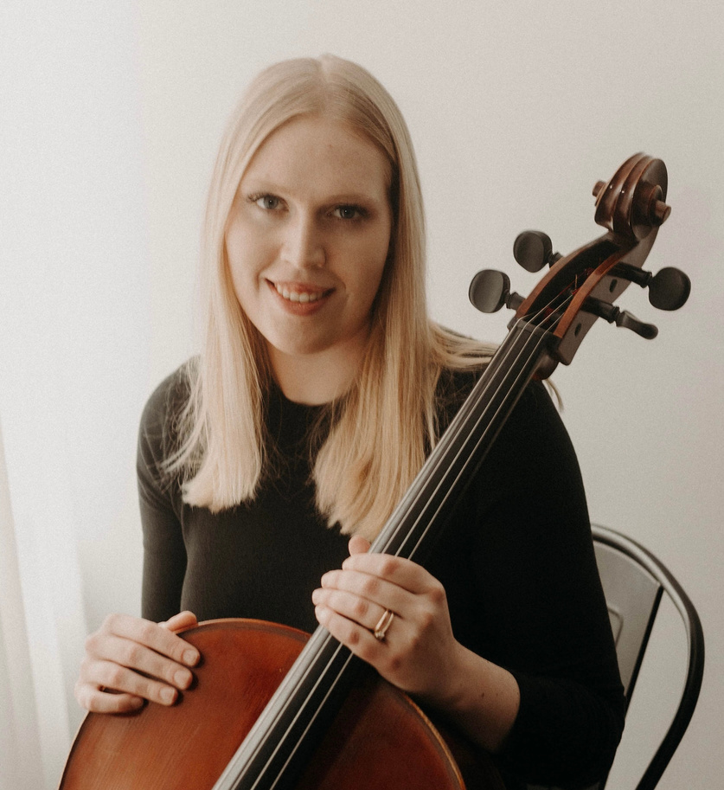


MUSIC
EXERCISE
HANNAH
PIETRA
MS, LCAT, MT-BC
2025
CNY YOUTH
MENTAL
HEALTH
SUMMIT
PRESENTED BY

Slide 2
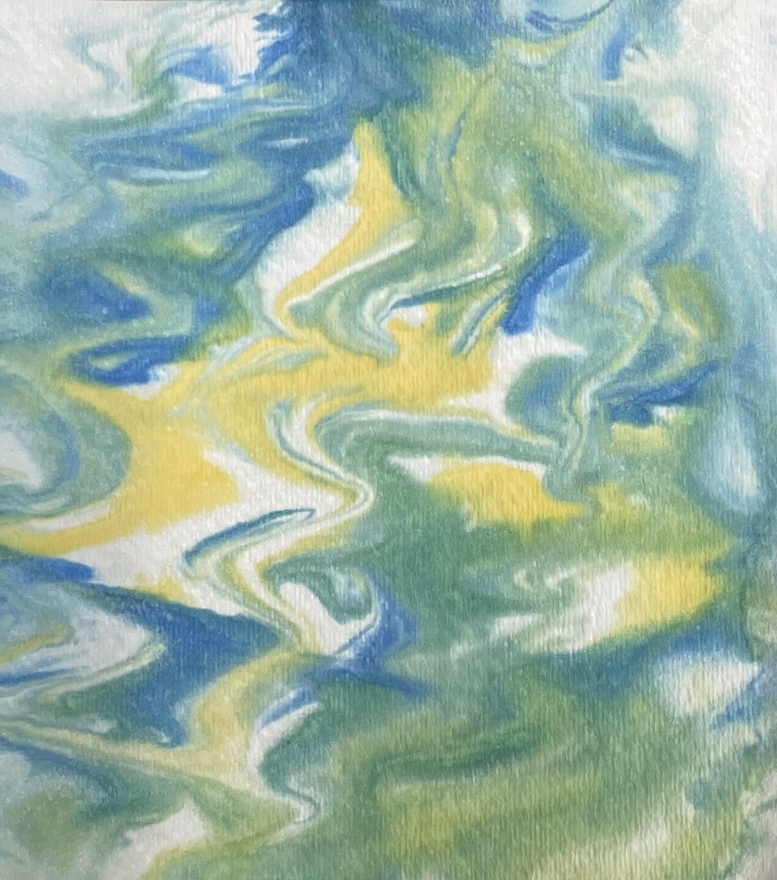

Hannah Pietra, MS, LCAT, MT-BC, CLC
Licensed Creative Arts Therapist, Board Certified Music Therapist, Certified Life Coach
Arts & Minds Coordinator and Clinician
at Syracuse Jewish Family Service
4101 E.Genesee St, Syracuse, NY 13214
Website: sjfs.org
Email: pietrah@sjfs.org
Phone: 315-446-9111 ext.130

Slide 3
Funga Alafia
Funga alafia, ah-shay ah-shay.
Funga alafia, ah-shay ah-shay.
Funga alafia, ah-shay ah-shay.
Funga alafia, ah-shay ah-shay.
My thoughts welcome you
My eyes welcome you
My words welcome you
My heart welcomes you

Slide 4
Session 1 Breakouts
The Power of Music for Teen Mental Health Hannah Pietra, MS, LCAT, MT-BC Liberty I
The Body Project Afton Kapuscinski, Ph.D. Liberty IV
SCORE: A Student-Led Workshop on Understanding Issues Impacting Youth Today Moderated by Monica Bacote, CDP
Liberty III
Understanding Grief & Trauma in Youth Rachel Johnson, MSW, LMFT Liberty II

